Slide 1


Kubernetes Performance and Best Practices
Agile Brains Consulting
‹#›
©Agile Brains Consulting Inc. All rights reserved. Not to be reproduced without prior written consent.

Slide 2
Table of Content
Deployment Strategies
Resource Constraints
Monitoring
Volumes
Labels
Registry and Package Management
Agile Brains Consulting
‹#›
©Agile Brains Consulting Inc. All rights reserved. Not to be reproduced without prior written consent.

Slide 3
Exposing Service and Load Balancing

Slide 4
Access Services – What’s best for me ?
Internal access – it’s easy
curl http://$(kubectl get svc myservice --template='{{.spec.clusterIP}}'):8080/
External access – it’s not easy
NodePort type – services may clash due to same and limited number of ports
LoadBalancer type –
Cloud: Use cloud provider load balancing, e.g. ELB in AWS. ELB instance is provisioned that proxies traffic for the Service inside the K8s cluster
Bare metal: DaemonSet running HAProxy -> watch services annotation through k8s API -> HAProxy config file re-written using pod IPs -> HAProxy exposes ports 80 and 443 and exposed to outside traffic as NodePorts
Traffic – public load balancer – forward traffic to nodeports – haproxy does host path resolution through service annotation – traffic routed to pod ip
Agile Brains Consulting
‹#›
©Agile Brains Consulting Inc. All rights reserved. Not to be reproduced without prior written consent.
Notes:
Additionally, pods can be tagged with a label for recommended scheduling advice

Slide 5
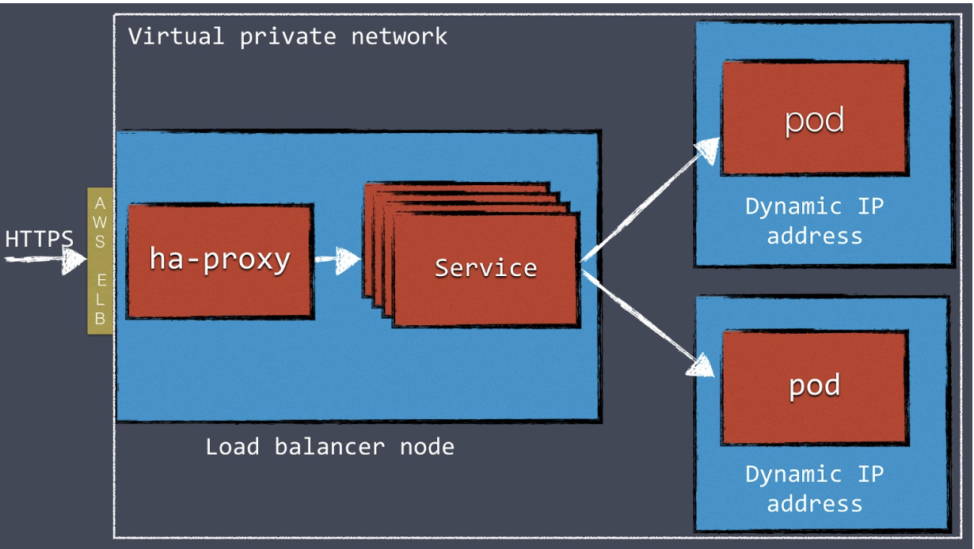
Two Step Load Balancing
Two step load balancing (in AWS)
Configure a load balancer such as HAProxy or NGINX in front of the Kubernetes cluster.
Use (for e.g.) AWS Elastic Load Balancer to route external web traffic to an internal HAProxy cluster.
Can configure internal HAProxy with a “back end” for each Kubernetes service, which proxies traffic to individual pods.
Agile Brains Consulting
‹#›
©Agile Brains Consulting Inc. All rights reserved. Not to be reproduced without prior written consent.
Notes:
Additionally, pods can be tagged with a label for recommended scheduling advice

Slide 6
OpenShift – External Load Balancer
OS SDN (software defined networking) – default overlay network
LB as OS node, thus including LB in the SDN itself
Run OS node on the load balancer itself. So, this node gets its own bridge that the SDN configures automatically to provide access to the pods. Mark this node as un-schedulable
LB as a pod
Even easier, simply run LB as a pod with the host port exposed. The pre-packaged HAProxy router in OS platform runs in this manner
Establish a tunnel using Ramp node
F5 BIG-IP host cannot run OS platform. Instead of enabling BIG-IP to reach pods, an existing node in the cluster can be a ramp node and establish tunnel between F5 BIG-IP host and the ramp node.
Agile Brains Consulting
‹#›
©Agile Brains Consulting Inc. All rights reserved. Not to be reproduced without prior written consent.
Notes:
Additionally, pods can be tagged with a label for recommended scheduling advice

Slide 7
Deployment

Slide 8
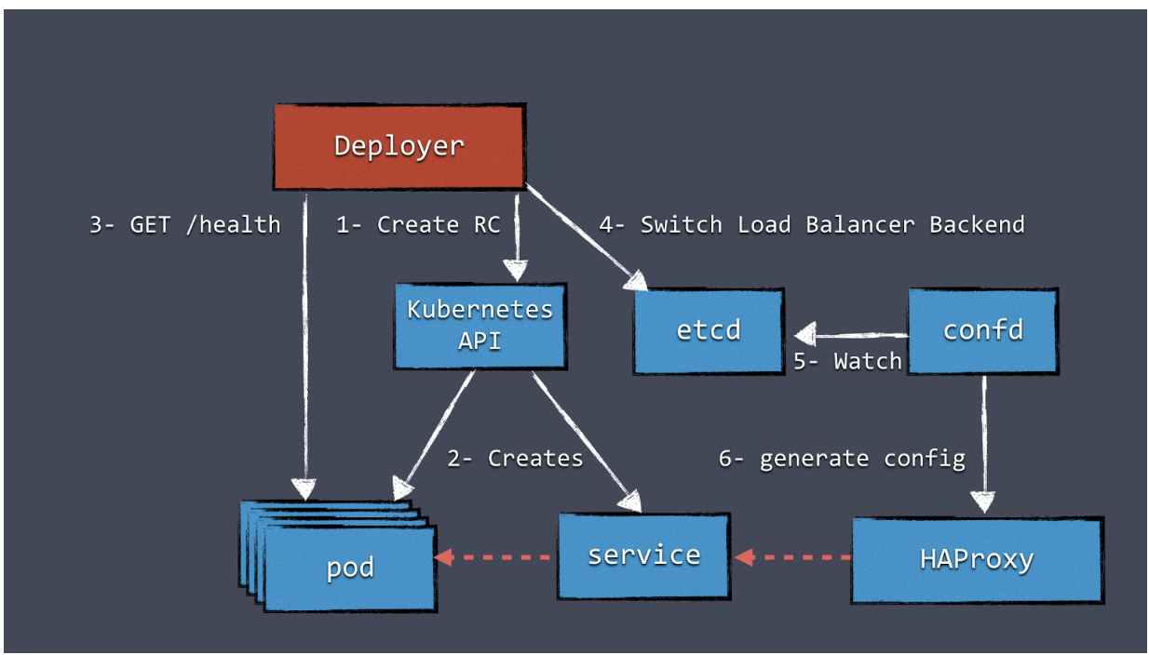
Deployment – Blue/Green or Rolling Update
Deployer orchestrates the deployment.
Can be influenced by open source projects like
https://bitbucket.org/amdatulabs/amdatu-kubernetes-deployer/src/master/
Health check
Important aspect - health checking on pods before switching the load balancer.
Implement Readiness and Liveness probes on pods
Log events
Deploy with {--record}
Agile Brains Consulting
‹#›
©Agile Brains Consulting Inc. All rights reserved. Not to be reproduced without prior written consent.
Notes:
Additionally, pods can be tagged with a label for recommended scheduling advice

Slide 9
Proper Deployment Parameters
spec:
replicas: 8
revisionHistoryLimit: 5
minReadySeconds: 20
type: RollingUpdate
strategy:
rollingUpdate:
maxUnavailable: 25%
maxSurge: 2
At least 6 pods out of 8 (75%) are always running
Prevents the expected number of replicas from being exceeded by more than 2 pods in order to avoid insufficient computing resources
Pod is considered stable only after staying in the Running phase for at least 20 seconds so that late crashes, typically due to timeouts, can automatically pause the deployment
Rolling Update parameters
Default
25% availability – for huge production workload, app could become unresponsive.
25% Surge – when running tight on resources, this could bring you too close to limits

Slide 10
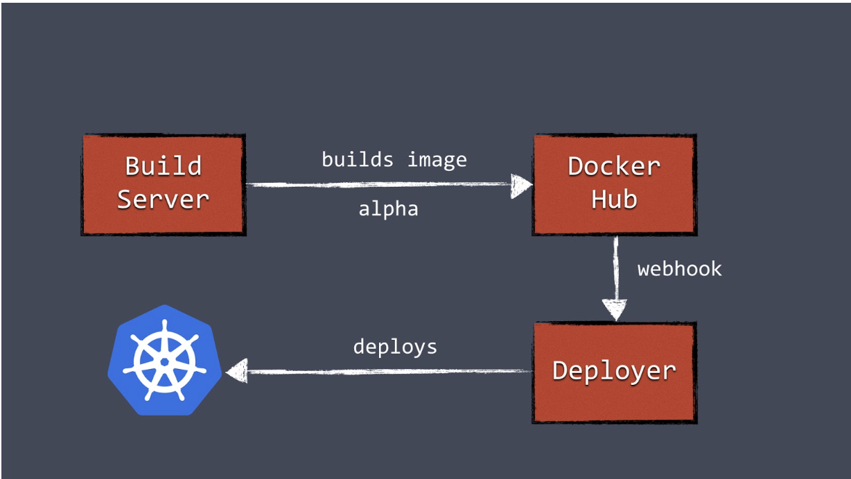
Making Deployments Automatic
Build Server
Build server, after a successful build, push a new Docker image to a registry such as Docker Hub.
Build server can invoke the Deployer to automatically deploy the new version to a test environment.
Agile Brains Consulting
‹#›
©Agile Brains Consulting Inc. All rights reserved. Not to be reproduced without prior written consent.
Notes:
Additionally, pods can be tagged with a label for recommended scheduling advice

Slide 11
Graceful Pod ShutDown
Pod killing process
Send SIGTERM
Wait (this wait period is a property of the podSpec that can be overridden)
Sends SIGKILL
If you have anything you need to do to ensure graceful shutdown then you need to implement a handler for SIGTERM, otherwise the process will get killed immediately and removed from etcd
Agile Brains Consulting
‹#›
©Agile Brains Consulting Inc. All rights reserved. Not to be reproduced without prior written consent.
Notes:
Additionally, pods can be tagged with a label for recommended scheduling advice

Slide 12
Know your Resource Constraints

Slide 13
Resource Constraints – Extremely Important
Configure resource requests and CPU/memory limits on each pod
Can also control resource guarantees
If you don’t constraint resources, containers may crash because they couldn't allocate enough memory
Request – what a container is guaranteed to get
Limit – container never goes above this value
CPU is defined in milli-cores and memory in bytes
Memory limits – if a container passes its memory limit, it will be terminated
CPU limits – if a CPU passes its CPU limits, k8s will throttle the container, but it won’t get killed
spec:
resources:
requests:
cpu: 200m
memory: 32Mi
limits:
cpu: 64m
memory: 64Mi
Agile Brains Consulting
‹#›
©Agile Brains Consulting Inc. All rights reserved. Not to be reproduced without prior written consent.
Notes:
Additionally, pods can be tagged with a label for recommended scheduling advice

Slide 14
Resource Constraints
The world is not ideal !! People may define the resource and forget OR set a very high limit.
Define ResourceQuota and LimitRange
Lock down namespace using quotas – e.g. no quota on prod and very strict on dev namespace
spec:
hard:
requests.cpu: 500m
requests.memory: 100Mib
limits.cpu: 700m
limits.memory: 500Mib
limits:
- default:
cpu: 600m
memory: 100Mib
min: …
max: …
ResourceQuota
Aggregated for all containers
LimitRange
Range for a single container
Agile Brains Consulting
‹#›
©Agile Brains Consulting Inc. All rights reserved. Not to be reproduced without prior written consent.
Notes:
Additionally, pods can be tagged with a label for recommended scheduling advice

Slide 15
Properly Monitored and Logged K8s Cluster

Slide 16
Centralized Logging and Monitoring
Monitoring and logging is crucial in this new dynamic environment
Logging into a server to look a log file doesn’t work anymore - large number of replicas and nodes
Plan to build centralized logging and monitoring
Options for Logging
Graylog, EFK – log management
Kafka – to collect and digest logs from containers
… lot others
Agile Brains Consulting
‹#›
©Agile Brains Consulting Inc. All rights reserved. Not to be reproduced without prior written consent.
Notes:
Additionally, pods can be tagged with a label for recommended scheduling advice

Slide 17
Monitoring – Application Specific
Kubernetes does an excellent job of recovering when there's an error.
Kubernetes recovery works so well that containers may crash multiple times a day because of a memory leak, without anyone noticing it.
* Nice to have – application-specific health checks and dashboards that monitors nodes and pods
- Measure load, throughput, application errors, and other stats
Options for Monitoring
InfluxDB, Heapster, cAdvisor, Grafana
Agile Brains Consulting
‹#›
©Agile Brains Consulting Inc. All rights reserved. Not to be reproduced without prior written consent.
Notes:
Additionally, pods can be tagged with a label for recommended scheduling advice

Slide 18
Data Stores

Slide 19
Data Store in K8s Volumes ??
With data, most of the times, reliability comes before performance
Most data stores require precise config; auto discovery and configuration of nodes is not common, which is by design an important characteristic of Kubernetes
A machine that runs a data store is often specifically tuned for that type of workload. Higher/lower IOPS
All these things don’t match very well with the dynamic nature of Kubernetes deployments
Agile Brains Consulting
‹#›
©Agile Brains Consulting Inc. All rights reserved. Not to be reproduced without prior written consent.
Notes:
Additionally, pods can be tagged with a label for recommended scheduling advice

Slide 20
Configuration Management
Loosely coupled
Keep config and code (image) separated, so config can be persisted even when containers are restarted, scaled up, scheduled to new nodes, etc.
Use ConfigMaps, Secrets, and Environment variables for configuration storage
Prefer using CM and secrets than environment variables – no access control, these are global variables, and few process like Cron & Monit may scrub environment variables
Agile Brains Consulting
‹#›
©Agile Brains Consulting Inc. All rights reserved. Not to be reproduced without prior written consent.
Notes:
Additionally, pods can be tagged with a label for recommended scheduling advice

Slide 21
Labels
A simple and powerful way to associate related entities
Use plenty of descriptive labels
Use labels to perform operations, node selection, deployments
Use labels to monitor the cluster – Build label specific metrics – to identify performance of entities at a {TYPE} level
Metrics at Pod and container level might not be too useful, instead visualize for a group of pods using labels
Agile Brains Consulting
‹#›
©Agile Brains Consulting Inc. All rights reserved. Not to be reproduced without prior written consent.
Notes:
Additionally, pods can be tagged with a label for recommended scheduling advice

Slide 22
Registries and Packages
Use secured registries
Do not trust arbitrary base images
Signed & secured image
No {latest} tag
Have team specific base images, yet keep base image small
Use Helm
Templates to define, install and upgrades k8s based application
Helps in streamlining CI/CD
Docker
Non-root user
One process per container
Crash cleanly with an error message
Agile Brains Consulting
‹#›
©Agile Brains Consulting Inc. All rights reserved. Not to be reproduced without prior written consent.
Notes:
Additionally, pods can be tagged with a label for recommended scheduling advice

Slide 23
Pod Scheduling and Others
There is a limit on number pods you can run per node
Default is 110 per node, change this in kubelet setting
https://kubernetes.io/docs/reference/command-line-tools-reference/kubelet/ (--max-pods)
Inotify errors
Scheduling more pods may give inotify errors (filesystem monitoring watchers)
Change this in all host. Either use Infra as code tools or run a container as a Daemon set to change these limits in all host
e.g. https://gist.github.com/brendan-rius/5ac9ec3dd7e196222c8b8b356f8973d2

Slide 24
Pod Scheduling and Others
Set CPU and Memory Limits asap
As discussed before
Scenario:- A containers using 200Mib memory but only 5% of a vCPU. Running xxx of these containers might end up scheduling lots in a node, resulting in OOM errors. K8s will eventually figure out, as OOM will evict pods and re-schedule, but this process may take time
Pod Isolation
Critical pods should be isolated by node affinity and anti-affinity

Slide 25
Reliability and Agility At Scale
https://www.youtube.com/watch?v=9C6YeyyUUmI
https://github.com/kubernetes-retired/contrib/tree/master/scale-demo

Slide 26
Follow 12 factor
https://12factor.net

